Slide 1
APPLICATION OF LOGIC Lecture # 06

Slide 2
Application of logic in Digital Logic Circuits.
Logic have application in many diverse fields. But we study the application of logic that have relevance in computer science.
We will see how logic will use to simplify the circuits. This idea is given by an American scientist, when he was not actually a scientist, he was just a student.
He note down the Analogy between the operation of switching devices and the operation of logical connectives. He identify that how to simply a circuit and the problems occurs in the circuit, how to solve them by using laws of logic.
He identify a method through which we simplify a circuit through logic.

Slide 3
Basic components of circuits
Switches “in series”
Switches “in parallel”
Notations:
a battery,
2 switches P & Q
Light bulb
If switches are open then current can not pass through them.

Slide 4
SWITCHES IN SERIES
Switches | Light Bulb
P Q | State
Closed Closed | On
Closed Open | Off
Open Closed | Off
Open Open | Off

Slide 5
SWITCHES IN PARALLEL
Switches | Light Bulb
P Q | State
Closed Closed | On
Closed Open | On
Open Closed | On
Open Open | Off

Slide 6
SWITCHES IN SERIES
Switches | Light Bulb
P Q | State
Closed Closed | On
Closed Open | Off
Open Closed | Off
Open Open | Off
P | Q | P ∧ Q
T | T | T
T | F | F
F | T | F
F | F | F

Slide 7
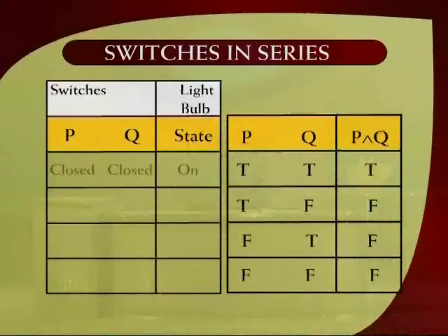

Slide 8
SWITCHES IN PARALLEL
Switches | Light Bulb
P Q | State
Closed Closed | On
Closed Open | On
Open Closed | On
Open Open | Off
P | Q | P ∨ Q
T | T | T
T | F | T
F | T | T
F | F | F

Slide 9
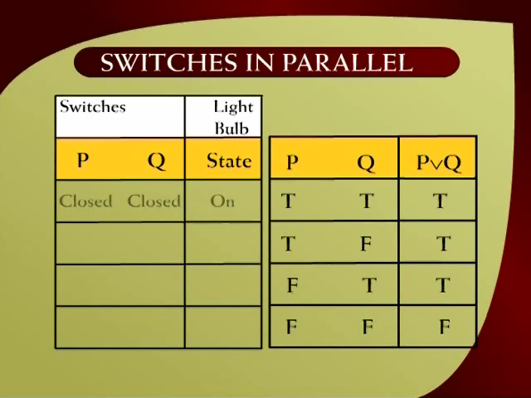

Slide 10
Vocabulary
Electronic engineer name these switches logical gates.
BULB | Output
ON | 1 | True
OFF | 0 | False

Slide 11
NOT GATE or INVERTOR
A NOT-gate (or inverter) is a circuit with one input and one output signal. If the input signal is 1, the output signal is 0. Conversely, if the input signal is 0, then the output signal is 1.
P
R
Input | Output
P | R
1 | 0
0 | 1

Slide 12
AND-GATE
An AND-gate is a circuit with two input signals and one output signal.
If both input signals are 1, the output signal is 1. Otherwise the output signal is 0.
Input |  | Output
P | Q | R
1 | 1 | 1
1 | 0 | 0
0 | 1 | 0
0 | 0 | 0
P

Slide 13
OR-GATE
An OR-gate is a circuit with two input signals and one output signal.
If both input signals are 0, then the output signal is 0. Otherwise, the output signal is 1.
Input |  | Output
P | Q | R
1 | 1 | 1
1 | 0 | 1
0 | 1 | 1
0 | 0 | 0

Slide 14
COMBINATIONAL CIRCUIT
A Combinational Circuit is a compound circuit consisting of the basic logic gates such as NOT, AND, OR.
Example:
s

Slide 15
Rules to form a COMBINATIONAL CIRCUIT
To combine two inputs we will MUST use any gate.
We can split input and use it for different gates.
The output of one gate can be use for input for other gates.
The output of one gate CANNOT be used for input for the same gate. (this rule is specific to combinational circuit, not implemented to other circuits)

Slide 16
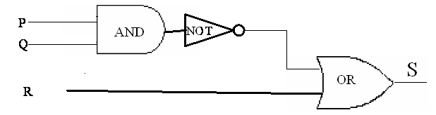
DETERMINING OUTPUT FOR A GIVEN INPUT
Indicate the output of the circuit below when the input signals are P = 1, Q = 0 and R = 0

Slide 17
OUTPUT FOR A GIVEN INPUT
P = 1, Q = 0 and R = 0
Output S = 1
1
0
1
0
0
1

Slide 18
INPUT/OUTPUT Table for a Circuit
Construct the input/output table for the following circuit.
LABELING INTERMEDIATE OUTPUTS

Slide 19
TRUTH TABLE FOR CIRCUIT
P | Q | R | X | Y | S
1 | 1 | 1 | 1 | 0 | 1
1 | 1 | 0 | 1 | 0 | 0
1 | 0 | 1 | 0 | 1 | 1
1 | 0 | 0 | 0 | 1 | 1
0 | 1 | 1 | 0 | 1 | 1
0 | 1 | 0 | 0 | 1 | 1
0 | 0 | 1 | 0 | 1 | 1
0 | 0 | 0 | 0 | 1 | 1

Slide 20
BOOLEAN VARIABLE & BOOLEAN EXPRESSION
The variable that have only two possible values, that variable is called Boolean Variable.
When we connect Boolean variables with different AND, OR and NOT connective, the resultant expression is called Boolean Expression.

Slide 21
FINDING A BOOLEAN EXPRESSION FOR A CIRCUIT
Find a Boolean expression for a circuit?

Slide 22
FINDING A BOOLEAN EXPRESSION FOR A CIRCUIT
Find a Boolean expression for a circuit?
Solution:
Trace through the circuit from left to right, writing down the output of each logic gate.
Hence is the Boolean expression for this circuit.
P ∨ Q
(P ∨ Q) ∧ (P ∨ R)
P ∨ R
(P ∨ Q) ∧ (P ∨ R)

Slide 23
Methods to describe a digital circuit
There are three methods to describe a digital circuit.
Draw it with the help of gates.
Describe any digital circuit with the help of truth table.
Write a Boolean expression for any digital circuit.

Slide 24
EXERCISE
Construct circuit for the Boolean expression
(P∧Q) ∨ ~R
SOLUTION

Slide 26
Exercise: Draw a circuit for a following Input/output Table
INPUTS |  |  | OUTPUT
P | Q | R | S
1 | 1 | 1 | 0
1 | 1 | 0 | 1
1 | 0 | 1 | 0
1 | 0 | 0 | 0
0 | 1 | 1 | 1
0 | 1 | 0 | 0
0 | 0 | 1 | 0
0 | 0 | 0 | 0

Slide 27
SOLUTION:
INPUTS |  |  | OUTPUT
P | Q | R | S
1 | 1 | 1 | 0
1 | 1 | 0 | 1
1 | 0 | 1 | 0
1 | 0 | 0 | 0
0 | 1 | 1 | 1
0 | 1 | 0 | 0
0 | 0 | 1 | 0
0 | 0 | 0 | 0
P ∧ Q ∧ ~R
~P ∧ Q ∧ R

Slide 28
CIRCUIT DIAGRAM:
Draw the circuit diagram of the Boolean expression:
(P ∧ Q ∧ ~R)
(~P ∧ Q ∧ R) = S
∨

Slide 30
Exercise:
Design a circuit to take input signals P, Q and R and output is 1 if, and only if, P and Q have the same value and Q and R have opposite values.
Solution:
Step1: Draw a table
Step 2: In output we have 1 only when we have same values of P and Q and opposite values of Q and R, both the conditions should be fulfilled.

Slide 31
INPUTS |  |  | OUTPUT
P | Q | R | S
1 | 1 | 1 | 0
1 | 1 | 0 | 1
1 | 0 | 1 | 0
1 | 0 | 0 | 0
0 | 1 | 1 | 0
0 | 1 | 0 | 0
0 | 0 | 1 | 1
0 | 0 | 0 | 0
S ≡ (p ∧ q ∧ ~r) ∨ (~p ∧ ~q ∧ r) Boolean Expression
P ∧ Q ∧ ~R
~ P ∧ ~ Q ∧ R

Slide 32
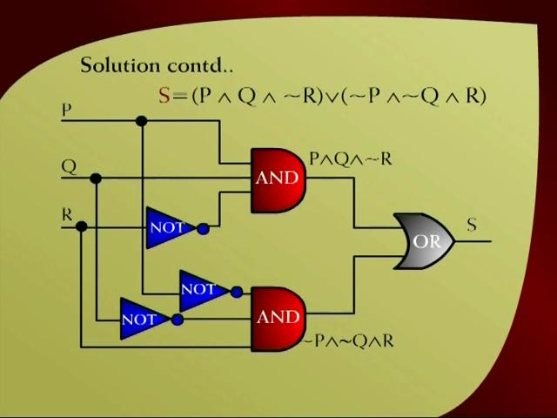

Slide 33
EXERCISE:
Find the Boolean expression for this circuit and simplify by using laws of logic.

Slide 34
Solution
Boolean Expression:
(P ∧ Q) ∨ (~P∧ Q) ∨ (P ∧ ~Q) ≡ S

Slide 35
Solution Cont…
(P ∧ Q) ∨(~P ∧ Q) ∨ (P ∧~ Q)
≡ (P ∧ Q) ∨ (~P ∧ Q) ∨ (P ∧~ Q)
≡ (P ∨ ~P) ∧ Q ∨ (P ∧~ Q) Distributive law
≡ t ∧Q ∨ (P ∧~ Q) Negation law
≡ Q ∨ (P ∧~ Q) Identity law
≡ (Q ∨ P) ∧ (Q ∨ ~ Q) Distributive law
≡ (Q ∨ P) ∧ t Negation law
≡ Q ∨ P Identity law
≡ P ∨Q Commutative law
Thus (P ∧ Q) ∨ (~P ∧ Q) ∧ (P ∧~ Q) ≡ P ∨ Q
Notes:
p ∧ (q ∨ r) ≡ (p ∧ q) ∨ (p ∧ r)
p ∨ (q ∧ r) ≡ (p ∨ q) ∧ (p ∨ r)
Identity Laws: p ∧ t ≡ p p ∨ c ≡ p
Negation Laws: p ∨ ~ p ≡ t p ∧ ~ p ≡ c

